Slide 1

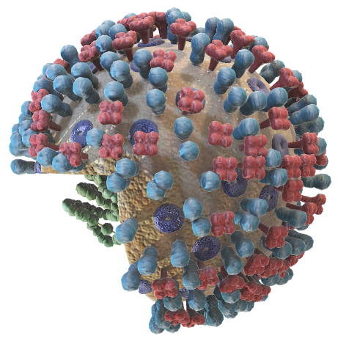
NIPAH PREDICTION
WHAT IS NIPAH ?
Nipah virus is a zoonotic virus that can be transmitted from animals to humans. It was first identified in 1999 during an outbreak among pig farmers in Malaysia. There is no treatment or vaccine available for either people or animals.
In September 2023, India reported a Nipah virus outbreak in Kerala. The Ministry of Health and Family Welfare, Government of India implemented public health response measures to contain the outbreak
IMS ENGINEERING COLLEGE (GHAZIABAD)

Slide 2
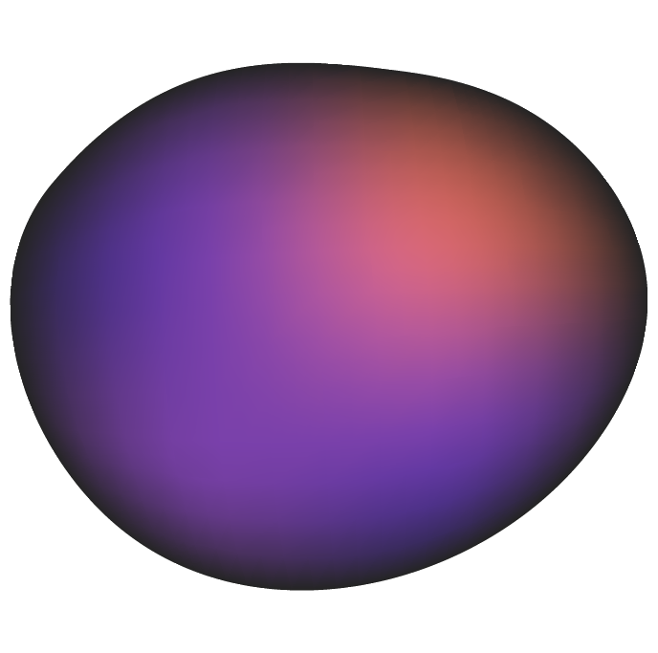
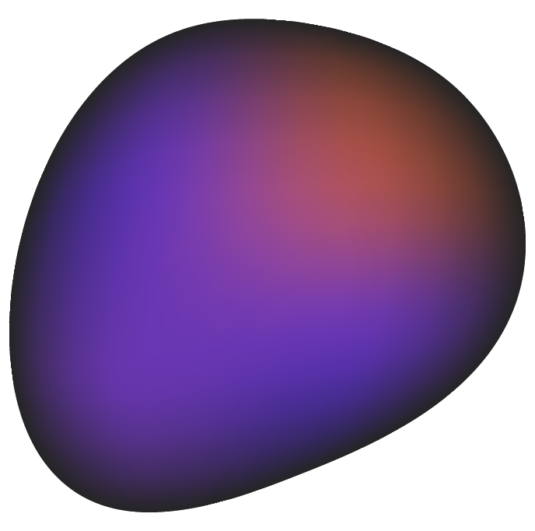

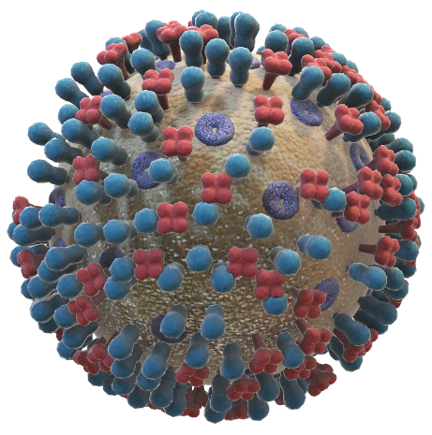
WHAT IS NIPAH ?
Nipah virus is a zoonotic virus that can be transmitted from animals to humans. It was first identified in 1999 during an outbreak among pig farmers in Malaysia. There is no treatment or vaccine available for either people or animals.
In September 2023, India reported a Nipah virus outbreak in Kerala. The Ministry of Health and Family Welfare, Government of India implemented public health response measures to contain the outbreak

Slide 3
NIPAH SYMPTOMS
NIPHA PREDICTION
SOFT COMPUTING
(used in creating a Model
Web Technology
(used in developing an APP
MACHINE LEARNING
ARTIFICIAL NEURAL NETWORK
XML
JAVA/KOTLIN
BODY PAIN
FEVER
DIFFICULTY IN BREATHING
COLD

Slide 4
WHY DO WE CHOOSE THIS PROJECT?
TOOLS & TECHNOLOGY USED
01
02
03
NIPHA PREDICTION
PYTHON
AI/ML
JAVA/KOTLIN
SOFT COMPUTING
(used in creating a Model)
Web Technology
(used in developing an APP)
04
05
06
PYCHARM
ANDROID STUDIO
JUPYTER NOTEBOOK
MACHINE LEARNING
ARTIFICIAL NEURAL NETWORK
XML
JAVA/KOTLIN

Slide 5
NIPAH PREDICTION
WHAT IS NIPAH ?
Nipah virus is a zoonotic virus that can be transmitted from animals to humans. It was first identified in 1999 during an outbreak among pig farmers in Malaysia. There is no treatment or vaccine available for either people or animals.
In September 2023, India reported a Nipah virus outbreak in Kerala. The Ministry of Health and Family Welfare, Government of India implemented public health response measures to contain the outbreak

Slide 6
TOOLS & TECHNOLOGY USED
01
02
03
PYTHON
AI/ML
JAVA/KOTLIN
04
05
06
ANDROID STUDIO
JUPYTER NOTEBOOK
PYCHARM
The objective of this project is to develop a machine learning model that can predict the probability of Nipah virus infection in individuals based on their demographic and clinical data. The model will be trained on a dataset of confirmed Nipah virus cases and healthy controls, and will be evaluated using cross-validation techniques.

Slide 7
OBJECTIVE
Data collection: Collect demographic and clinical data from confirmed Nipah virus cases and healthy controls.
Data preprocessing: Clean and preprocess the data to remove missing values, outliers, and other errors.
Feature engineering: Extract relevant features from the data that can be used to predict Nipah virus infection.
Model selection: Select an appropriate machine learning algorithm for the task.
Model training: Train the selected model on the preprocessed data.
Model evaluation: Evaluate the performance of the model using cross-validation techniques.
Model deployment: Deploy the trained model to a web application or other platform for use by healthcare professionals.
The objective of this project is to develop a machine learning model that can predict the probability of Nipah virus infection in individuals based on their demographic and clinical data. The model will be trained on a dataset of confirmed Nipah virus cases and healthy controls, and will be evaluated using cross-validation techniques.

Slide 8
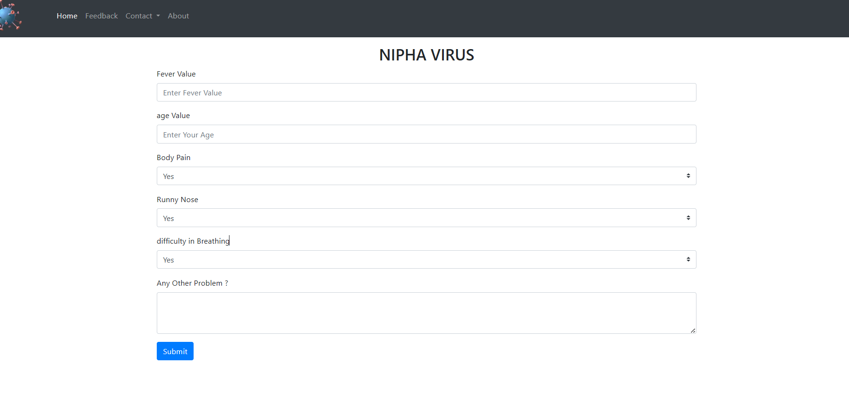
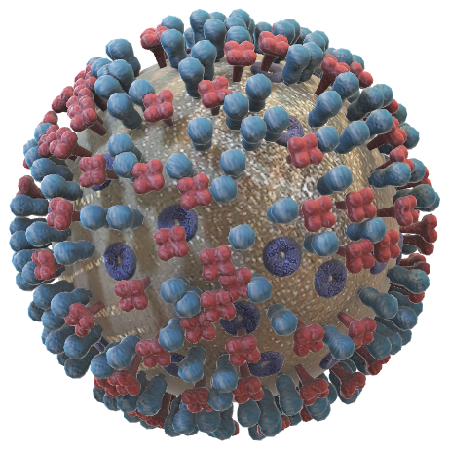
The project will involve the following steps:
Data collection: Collect demographic and clinical data from confirmed Nipah virus cases and healthy controls.
Data preprocessing: Clean and preprocess the data to remove missing values, outliers, and other errors.
Feature engineering: Extract relevant features from the data that can be used to predict Nipah virus infection.
Model selection: Select an appropriate machine learning algorithm for the task.
Model training: Train the selected model on the preprocessed data.
Model evaluation: Evaluate the performance of the model using cross-validation techniques.
Model deployment: Deploy the trained model to a web application or other platform for use by healthcare professionals.

Slide 9



NIPHA PREDICTION
Abhishek
Navdeep
Manu
We develop a machine learning model that can predict the probability of Nipah virus infection in individuals based on their demographic and clinical data.
Abhishek

Slide 10
OUR TEAM
Abhishek
Navdeep
Manu

